Slide 1
Customer Segmentation Analysis clustering models
Machine Learning

Slide 2

Who are our customers?
Objective:
Segment customers to better understand their characteristics and behaviors.

Slide 3
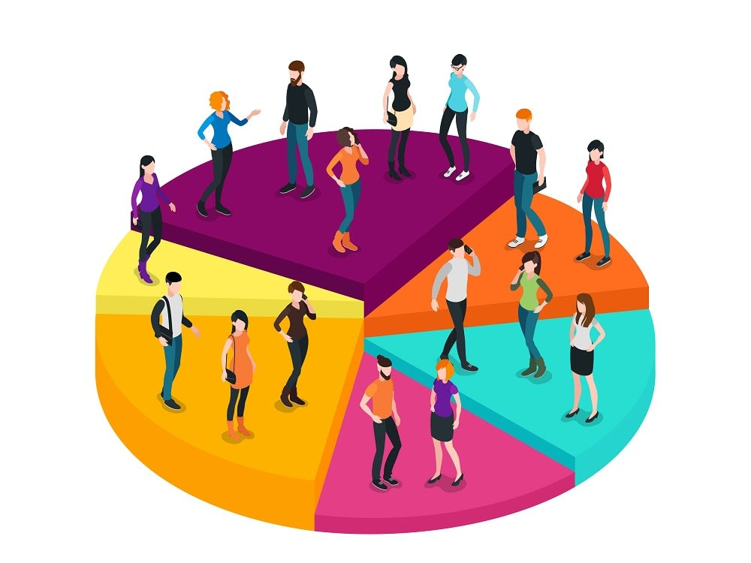
how to solve the problem
We apply clustering techniques to uncover hidden patterns

Slide 4
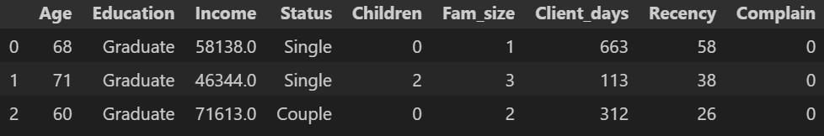
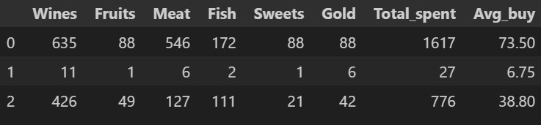
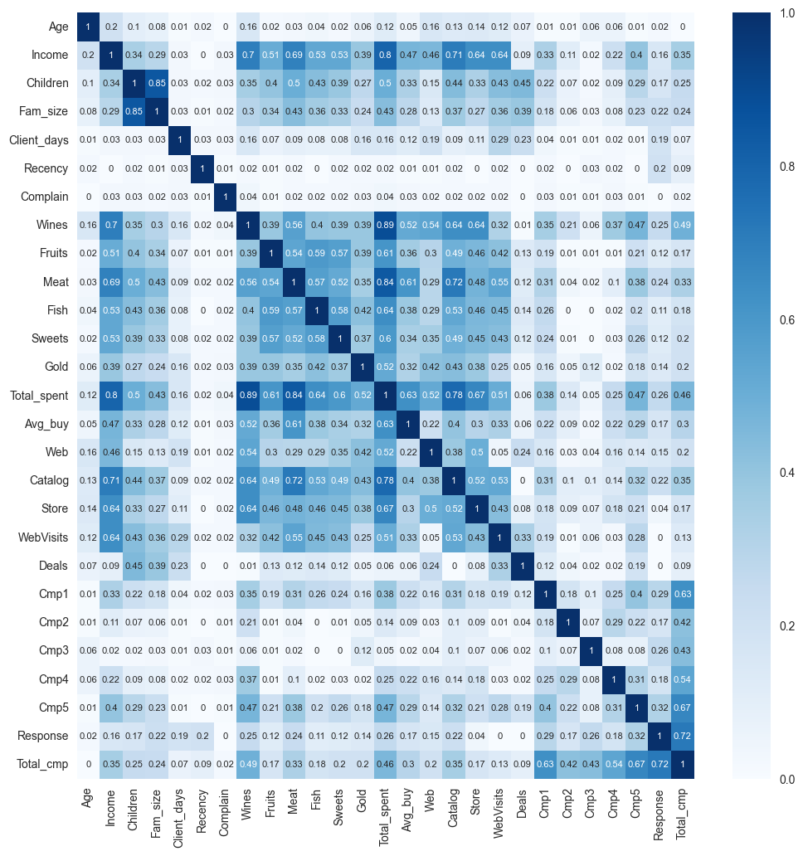
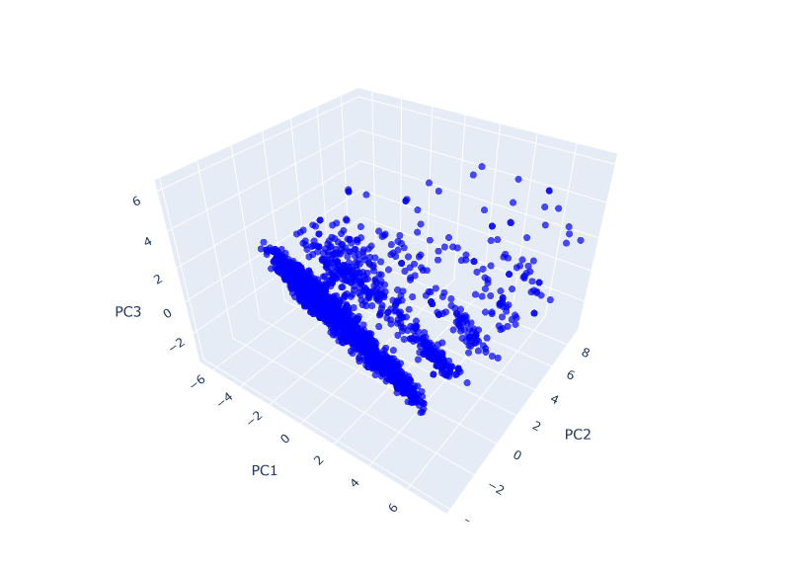
Dataset
Demographics, consumption, promotions
Data cleaning
Demographics, consumption, promotions
Dimensionality Reduction
Application of PCA to reduce dimensions

Slide 5
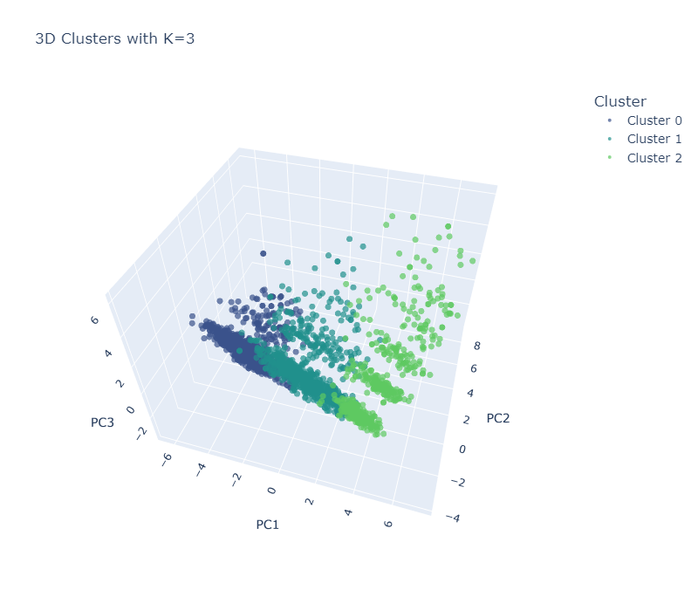
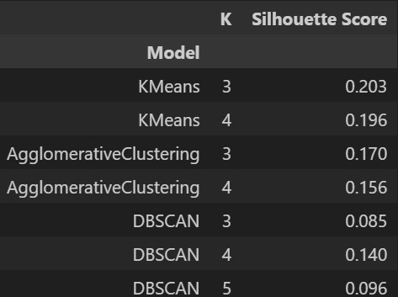
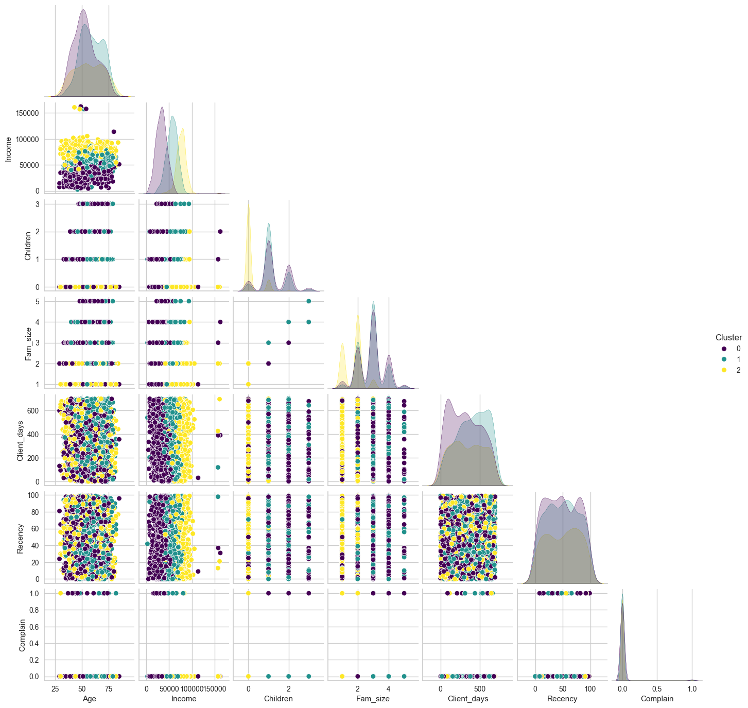
KMEANS, DBSCAN, AGGLOMERATIVE
Clustering models

Slide 6
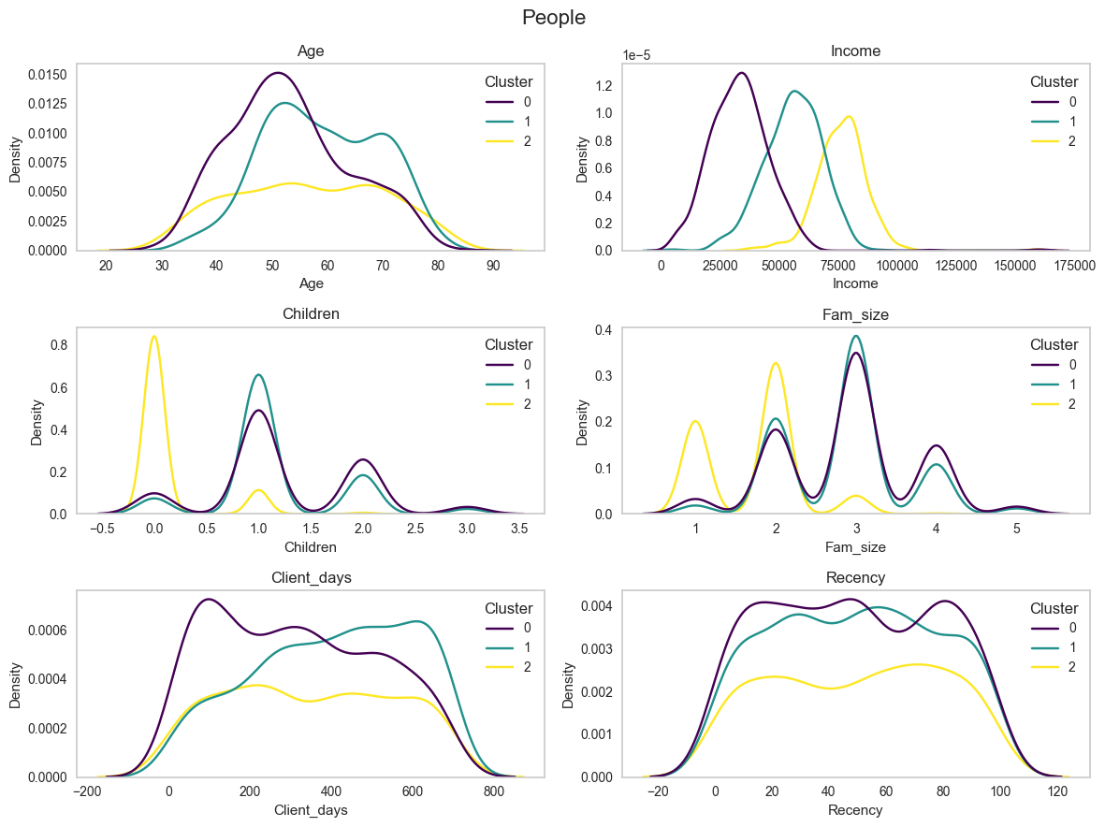
Profiles
Cluster 0 Digital curious | Cluster 1 Deal hunters | Cluster 2 Exclusive Elite
Low spending | Moderate spending | High spending
Lower income | Medium income | Higher income
Larger family | Medium family | Small family
Middle aged (40-60) | Old aged (50-75) | Any age (35-75)
New client | Old client | Long-term client
Many visits to the website, but not to buy | Web shopping preference | Catalog and store purchase preference
Doesn't respond to Marketing | Slight response to Marketing | Good response to marketing
Slight interest in deals | High interest in deals | Low interest in deals
Customer segmentation

Slide 7

Next steps
¿and now?
Create functional model to segment new customers
Combine with supervised models
Validate clusters with real results
Integrate temporal data
Notes:
*"¿Cómo aprovechamos este conocimiento? Aquí algunas ideas

Slide 8

Knowing the customer is the first step in building customer loyalty
A bright future

Slide 9
Thank you for your attention
Carlos Noya Torrecillas
BootCamp Data Science – The Bridge

